Slide 1
Exploring Text A Journey Through Natural Language Processing with Python

Slide 2
Agenda
Introduction to NLP & Text Preprocessing
Sentiment Analysis & Text Classification
Named Entity Recognition (NER) & Topic Modeling
Word Embeddings
Multimodal NLP (Text + Image + Speech)

Slide 3
Introduction to NLP & Text Preprocessing
Overview of Natural Language Processing (NLP)
Applications of NLP in real-world scenarios
Setting up the NLP environment with Python (NLTK, spaCy)
Text Preprocessing:
Tokenization (word and sentence-level)
Stopword removal
Lemmatization vs. Stemming
Handling special characters, numbers, and punctuation
Sentiment Analysis & Text Classification
Introduction to Sentiment Analysis
Rule-based vs. Machine Learning-based sentiment analysis
Implementing sentiment analysis using pre-trained models (TextBlob)
Text Classification:
Overview of text classification techniques
Feature extraction (TF-IDF, Bag of Words, Word Embeddings)
Building a text classifier using Scikit-learn and Deep Learning models

Slide 4
Word Embeddings
Understanding word vectors (Word2Vec, GloVe)
Using pre-trained embeddings for NLP tasks
Named Entity Recognition (NER) & Topic Modeling
Named Entity Recognition (NER):
Introduction to entity recognition
Using spaCy and transformers for NER
Topic Modeling:
Introduction to Latent Dirichlet Allocation (LDA) and Latent Semantic Analysis (LSA)
Topic extraction from large text datasets

Slide 5
How are we talking?

Slide 6
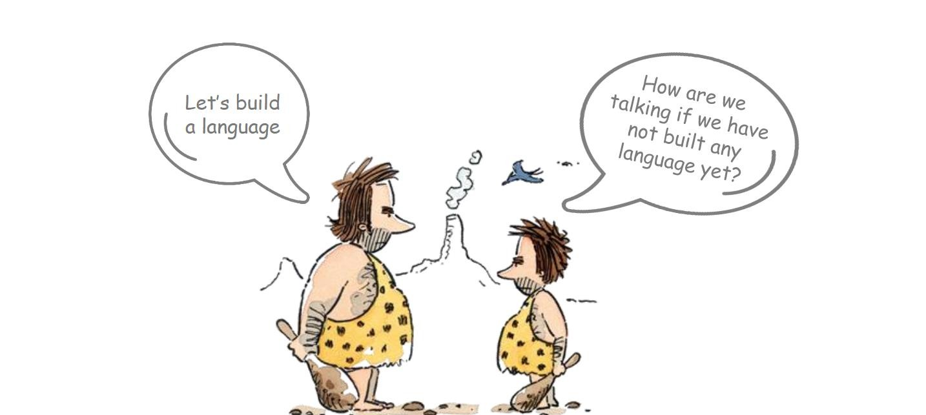

Slide 7
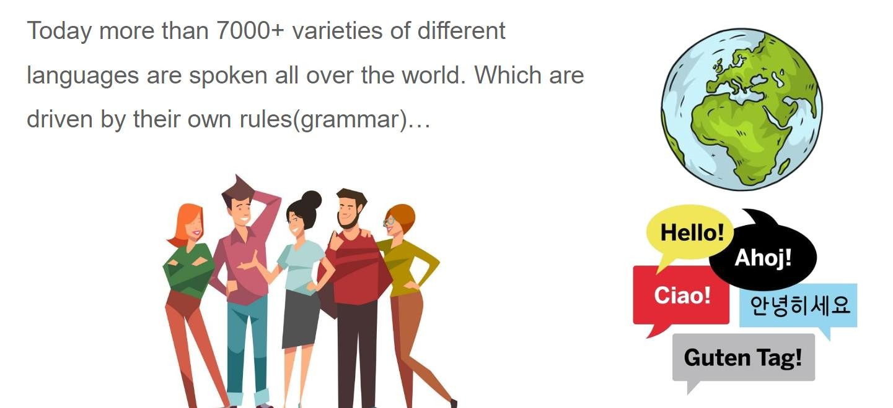

Slide 8
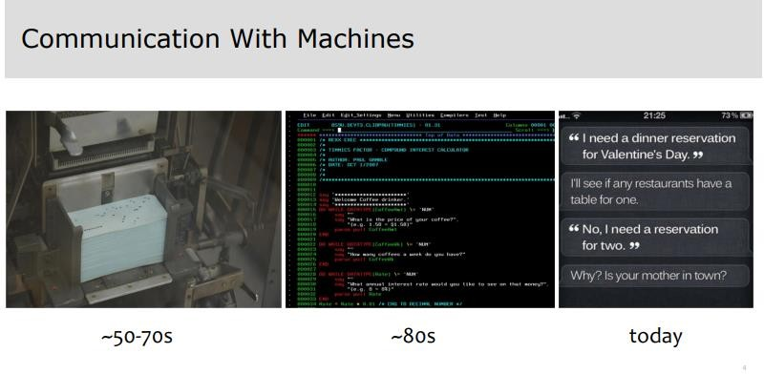

Slide 9
What is NLP?

Slide 10
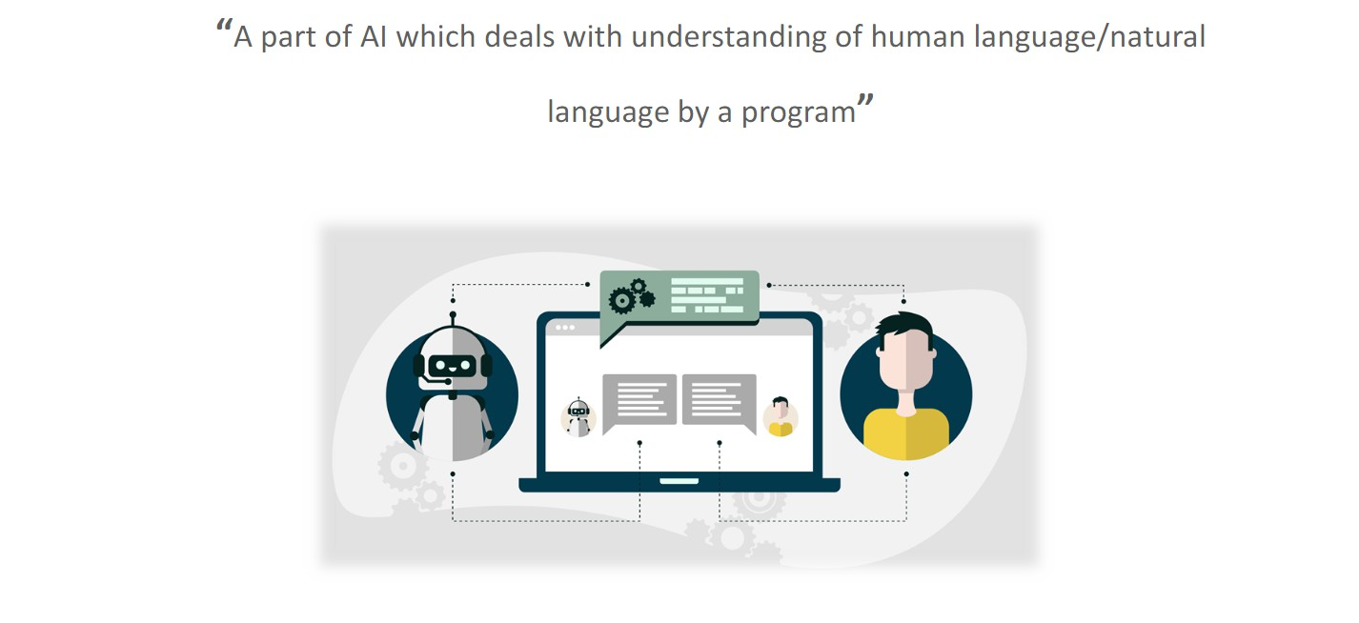

Slide 11
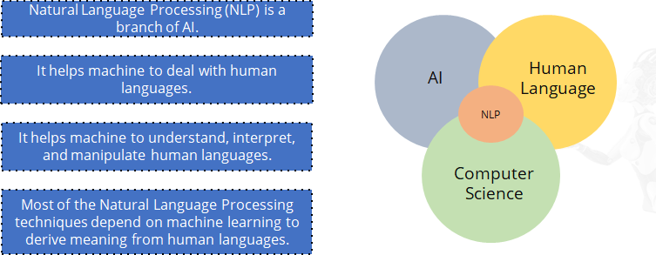
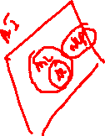

Slide 12
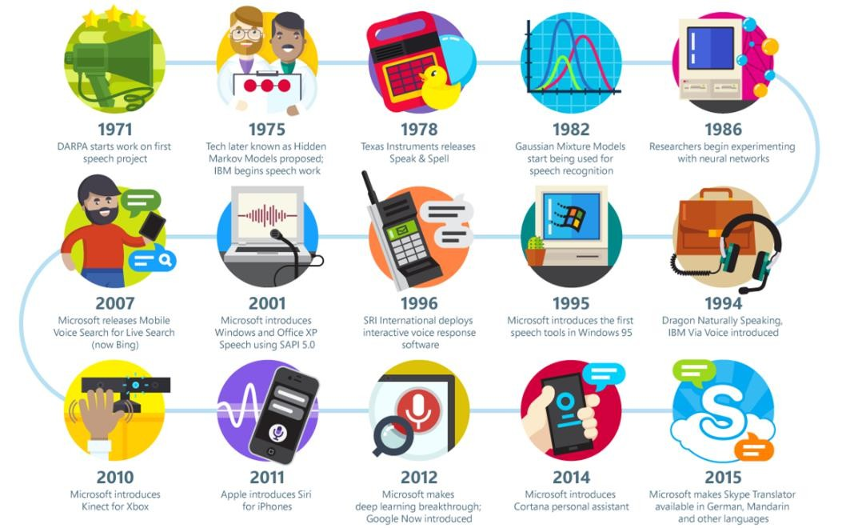

Slide 13
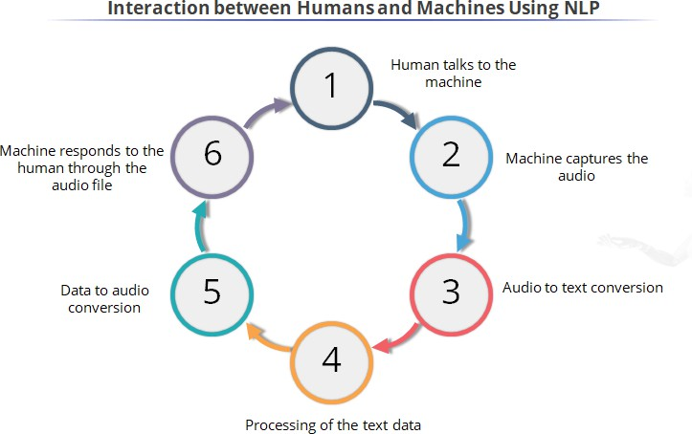

Slide 14
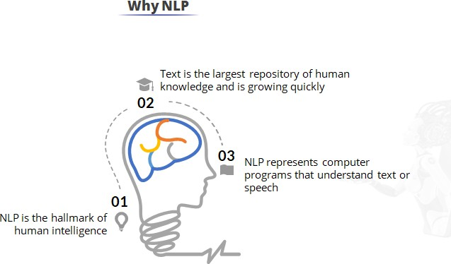
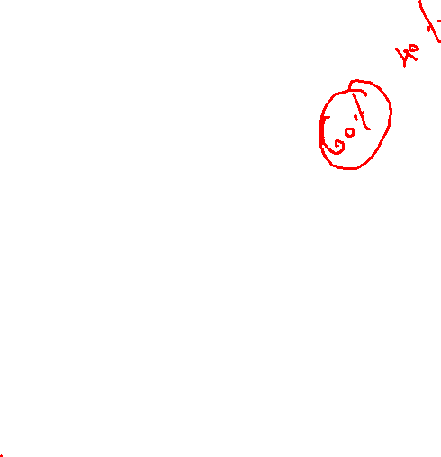

Slide 15
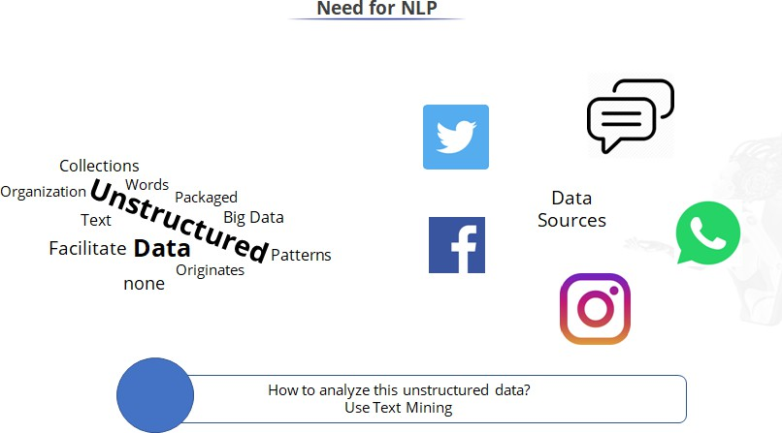

Slide 16
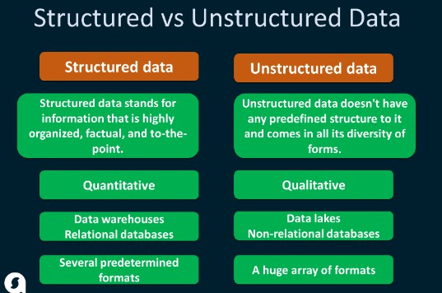

Slide 17
Applications of NLP

Slide 18
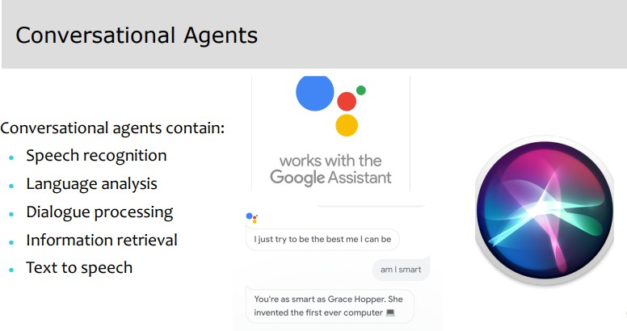

Slide 19
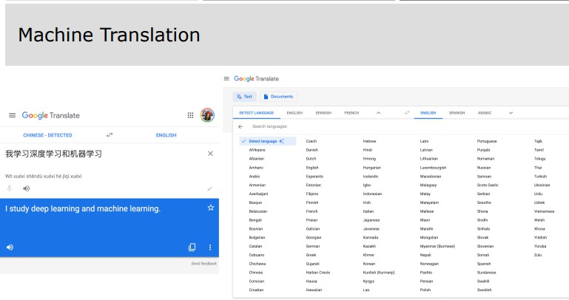

Slide 20
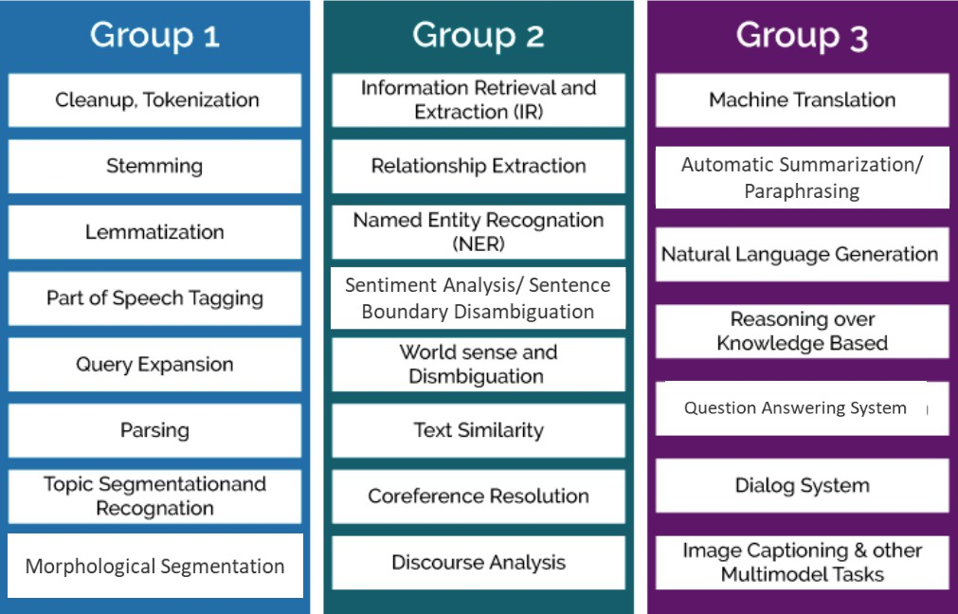

Slide 21
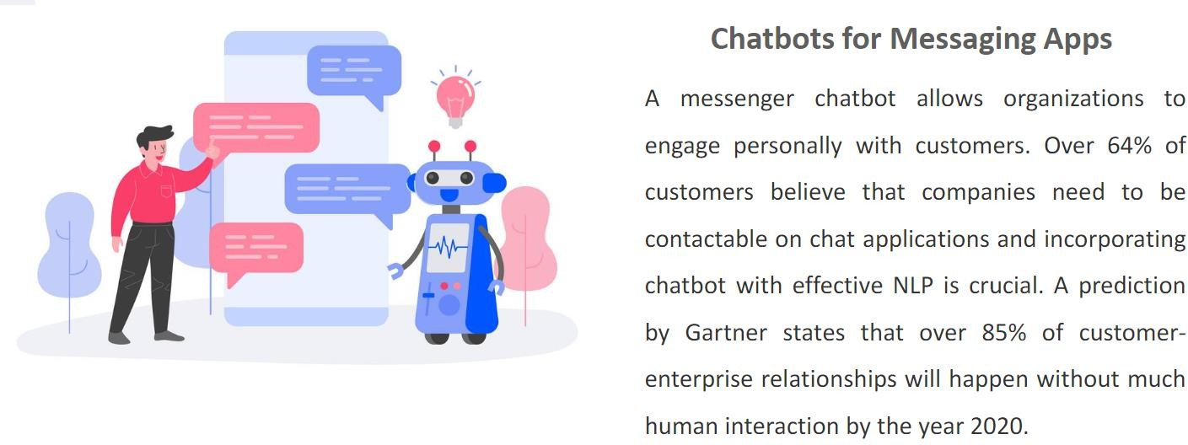
Demand for NLP

Slide 22
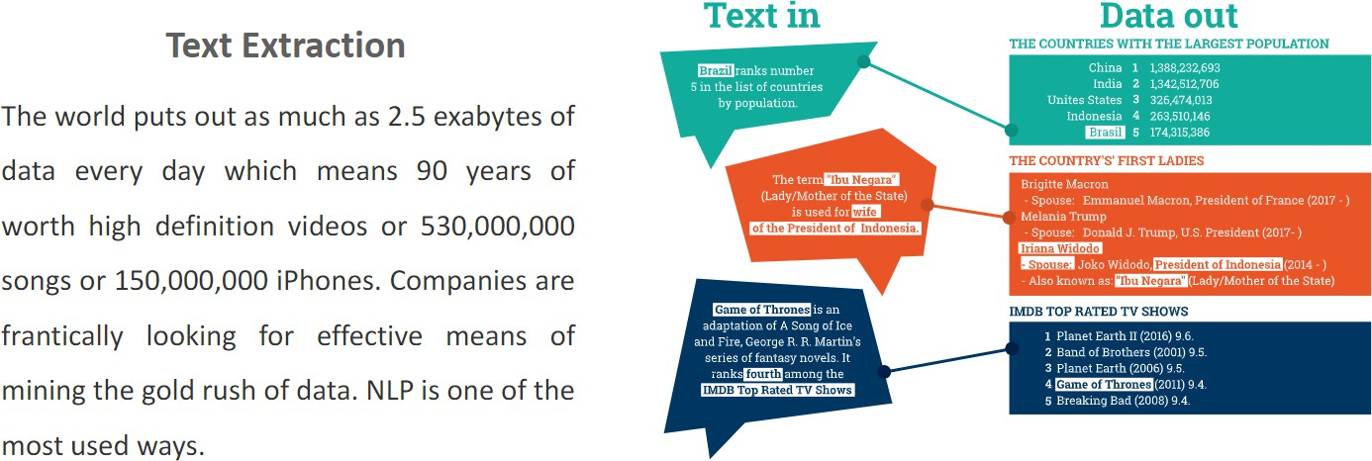
Demand for NLP

Slide 23
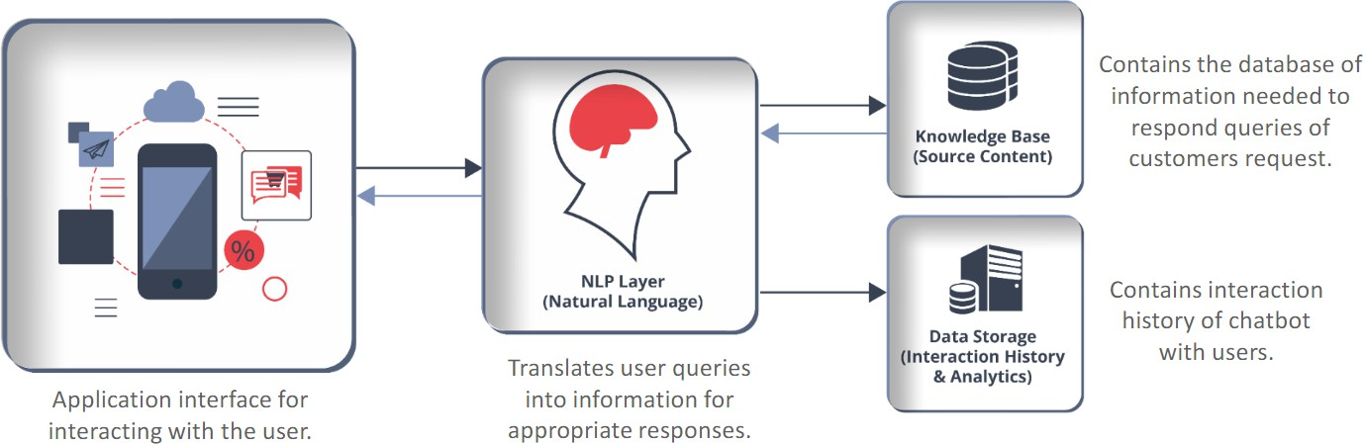
Basic structure of NLP

Slide 24
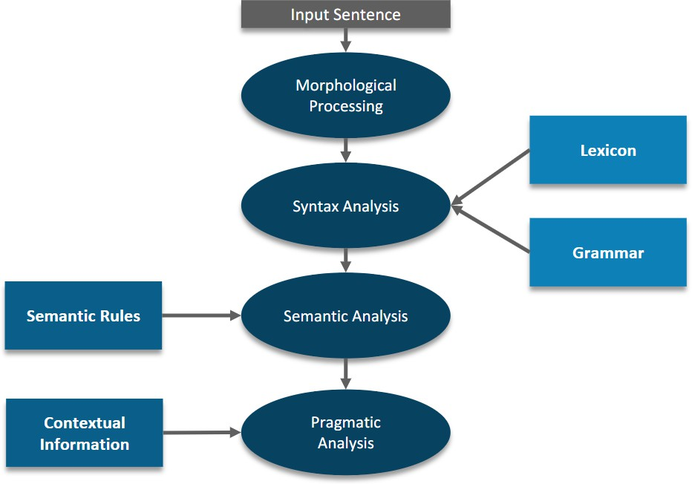
Components of NLP

Slide 25
Challenges

Slide 26
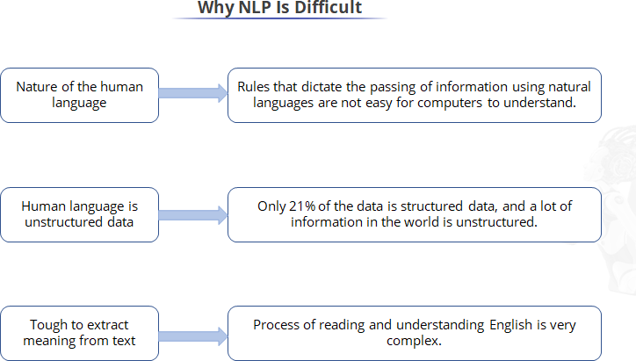

Slide 27
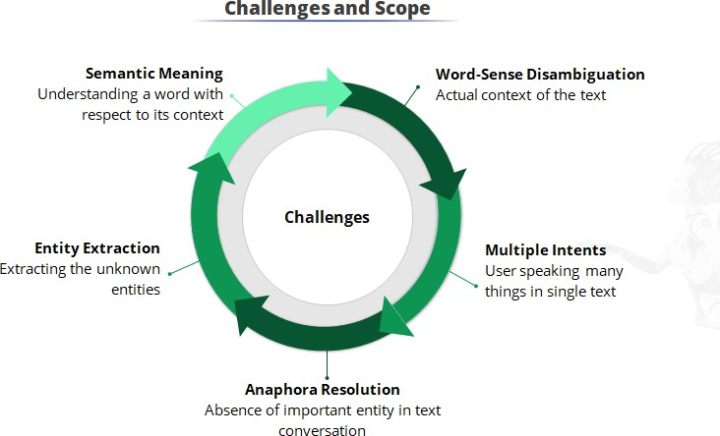

Slide 28
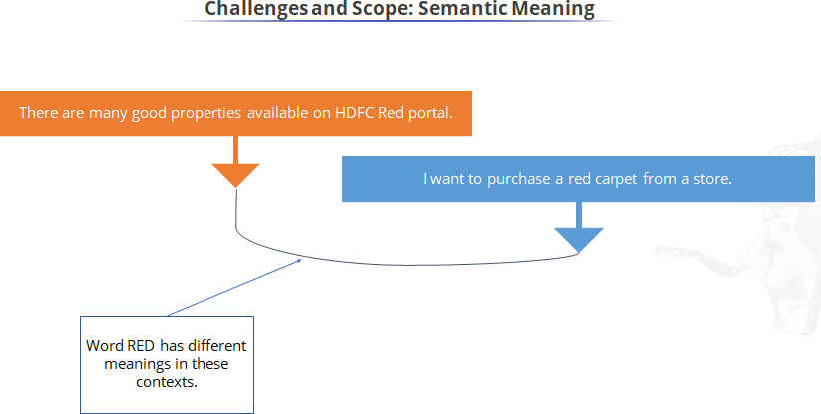

Slide 29
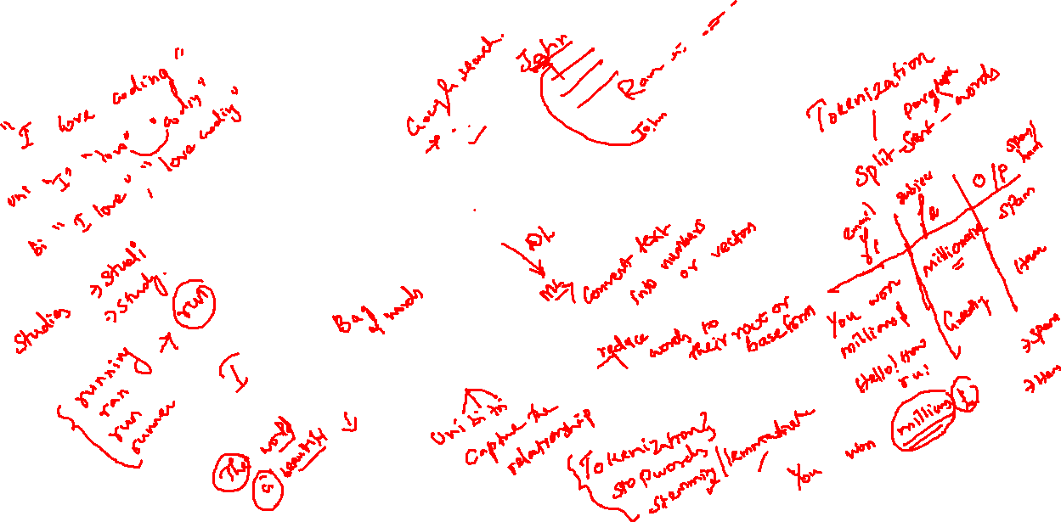
Roadmap of NLP
DL: RNN, LSTM: sentiment analysis
ML: Sentiment analysis, Topic modelling, spam
Text Preprocessing –III
word2vec
Text Preprocessing – II
BOW, Tfidf
Text Preprocessing - I
Tokenization,Ngrams, stemming, lemmatization, stopwords

Slide 30
Text Preprocessing

Slide 31
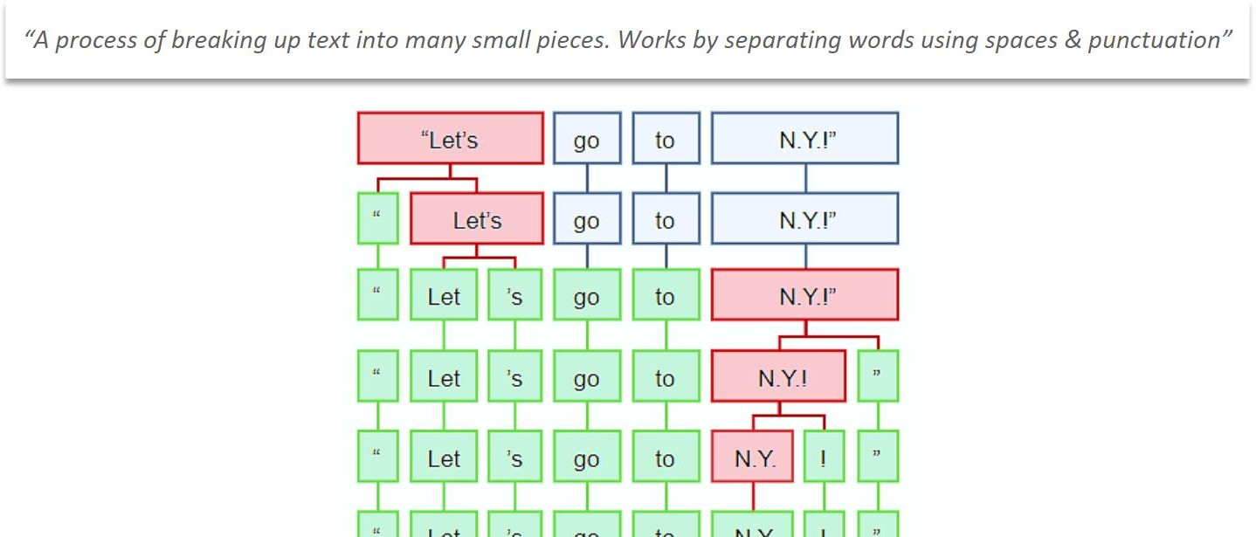
Tokenization

Slide 32
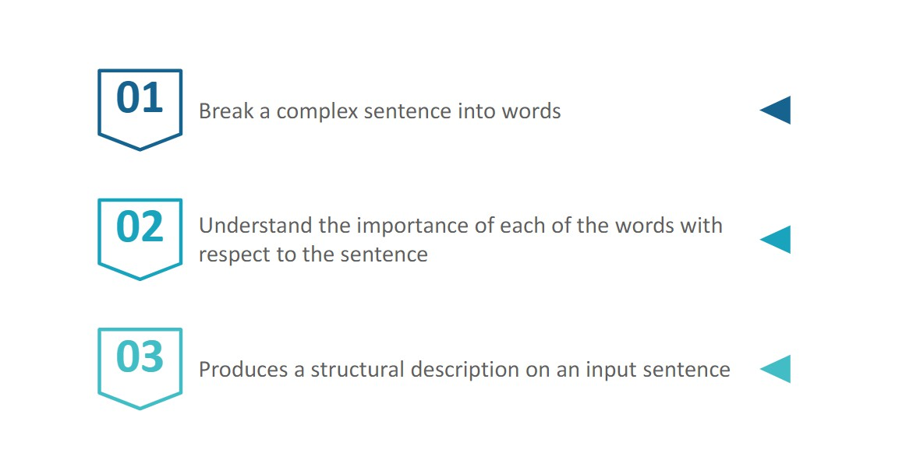
Use of Tokenization

Slide 33
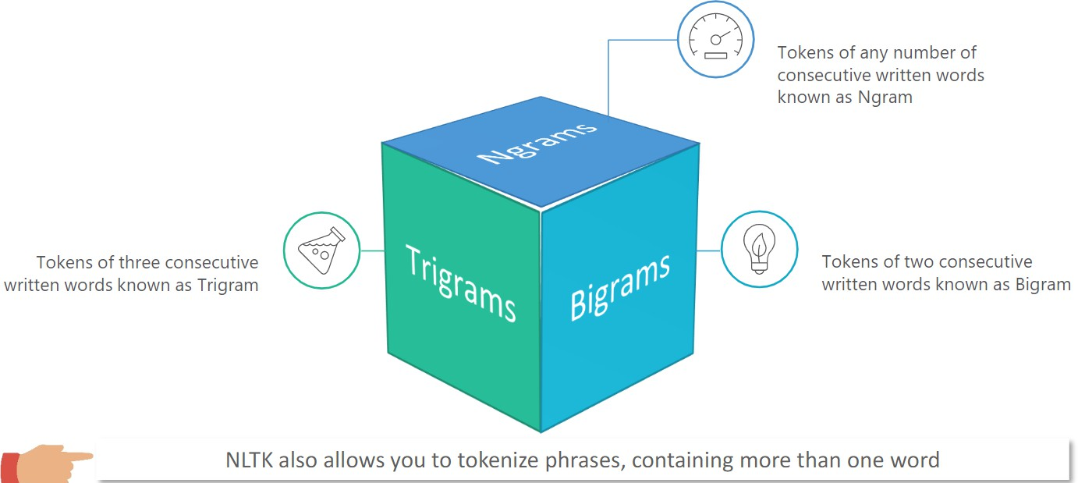
ngrams

Slide 34
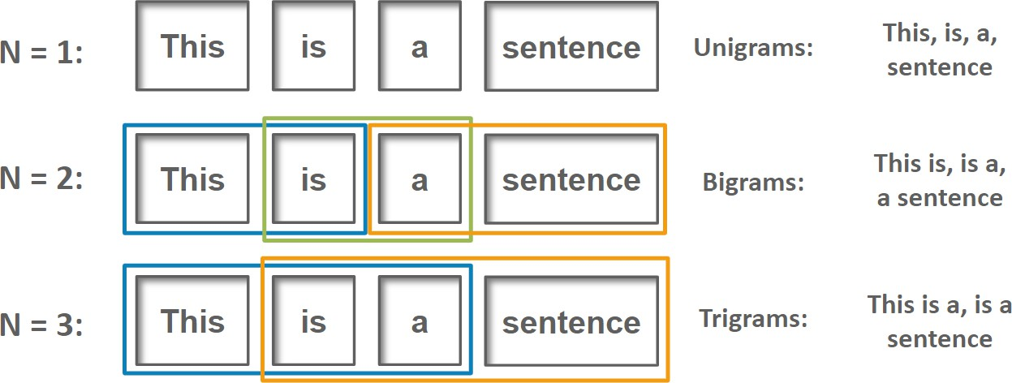

Slide 35
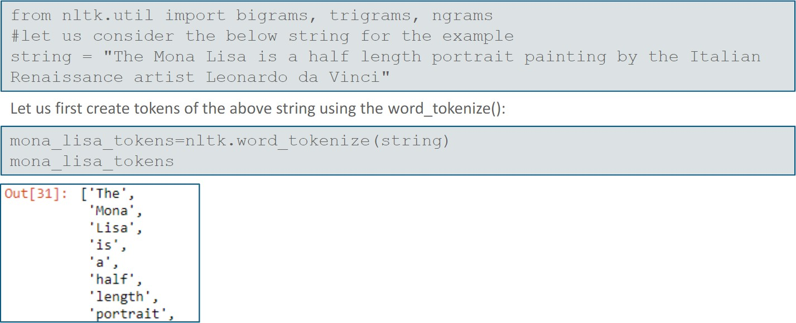

Slide 36
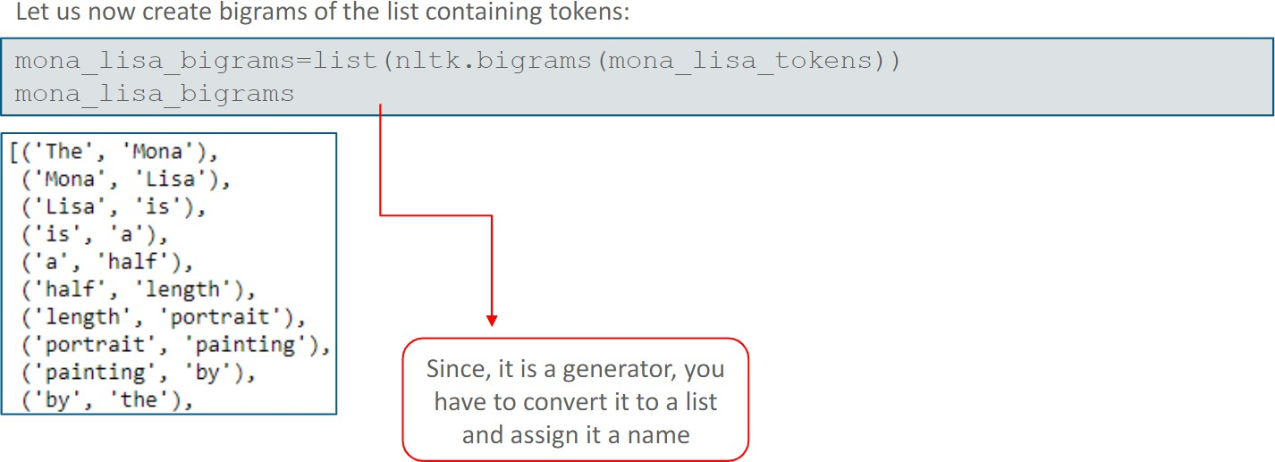

Slide 37
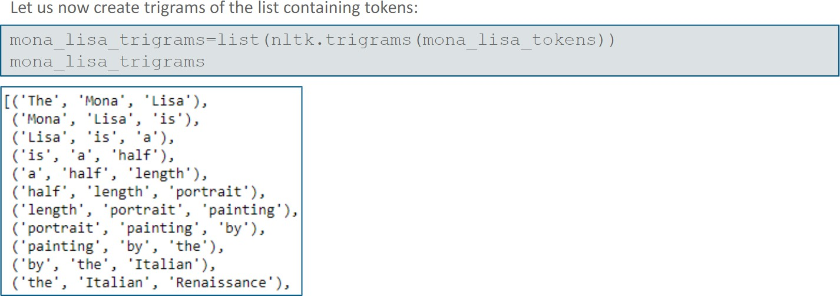

Slide 38
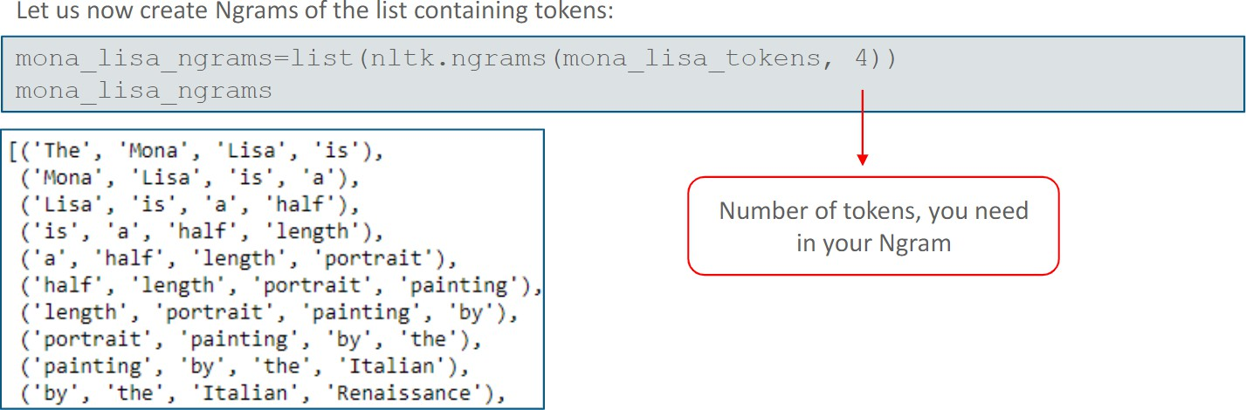

Slide 39
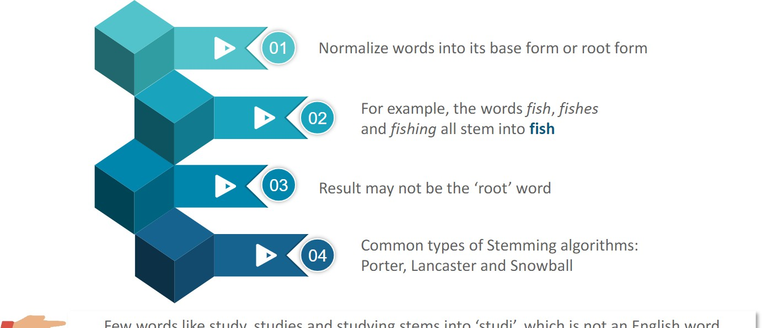
Stemming

Slide 40
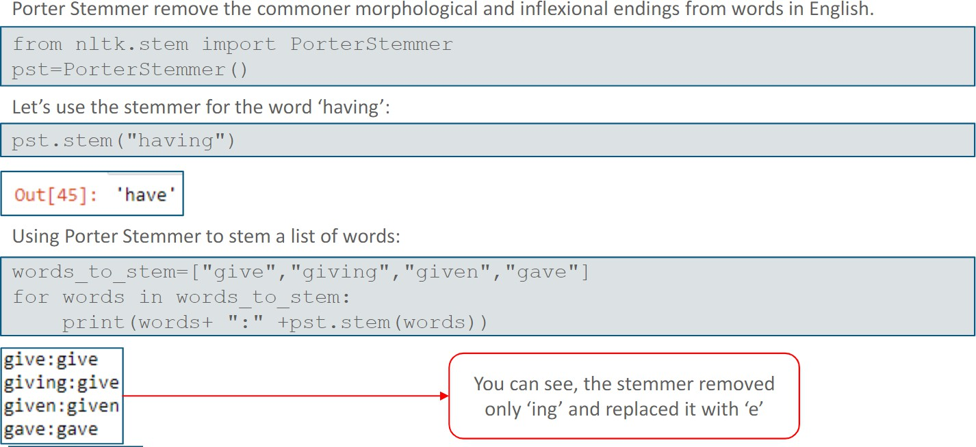

Slide 41
Lemmatization

Slide 42
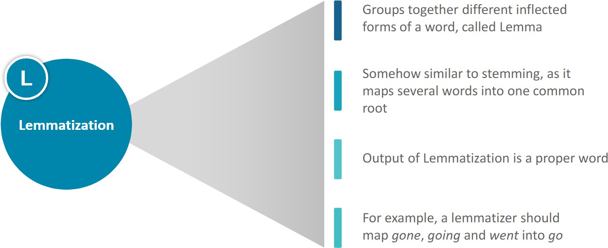

Slide 43
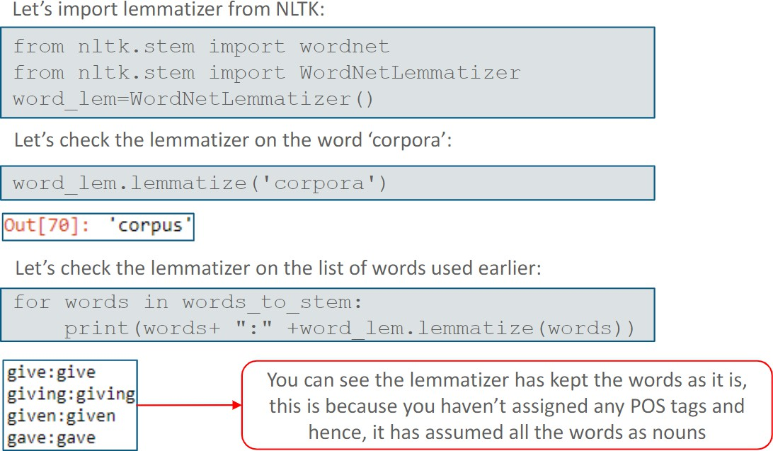

Slide 44
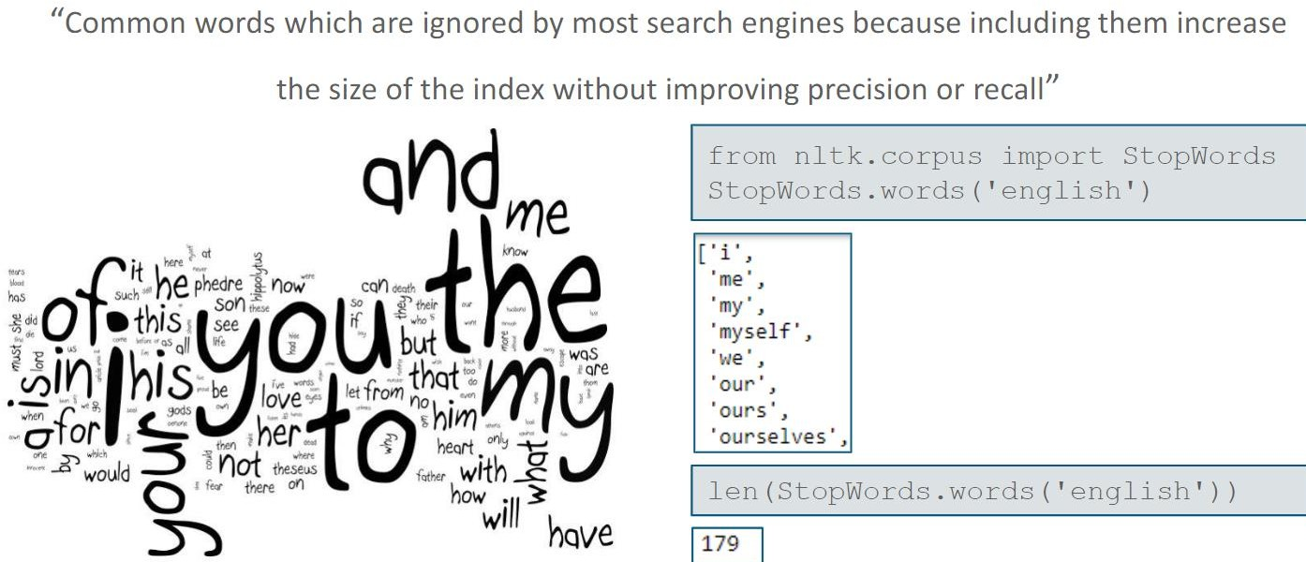
Stopwords

Slide 45
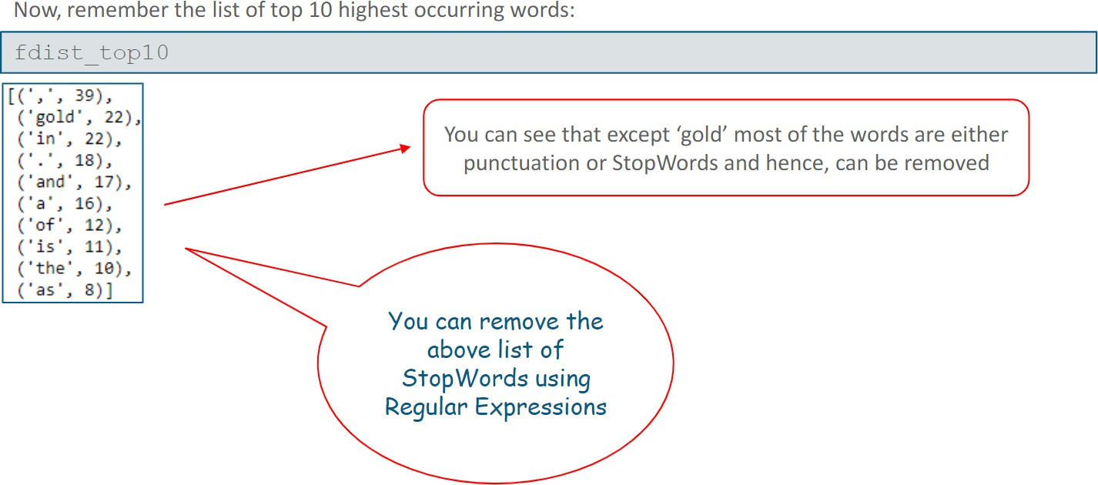

Slide 46
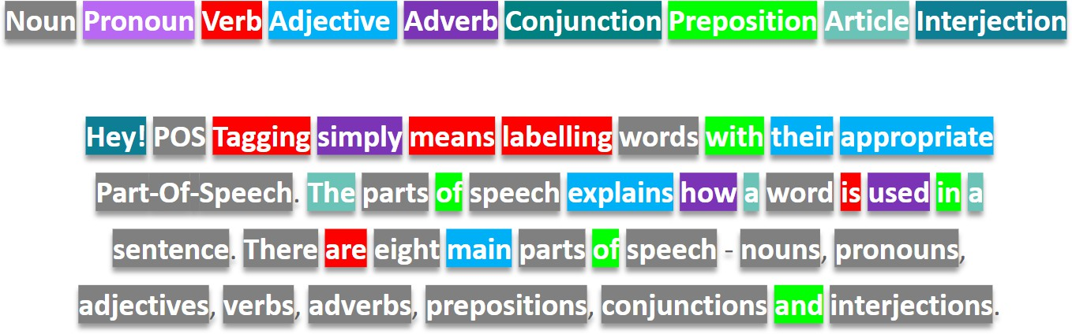
What is POS?

Slide 47
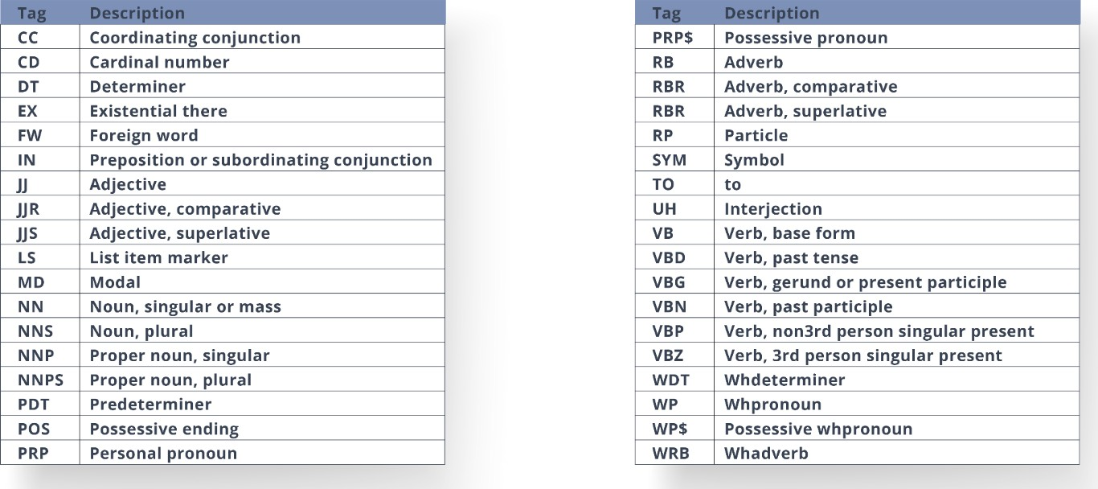
Common Tags

Slide 48
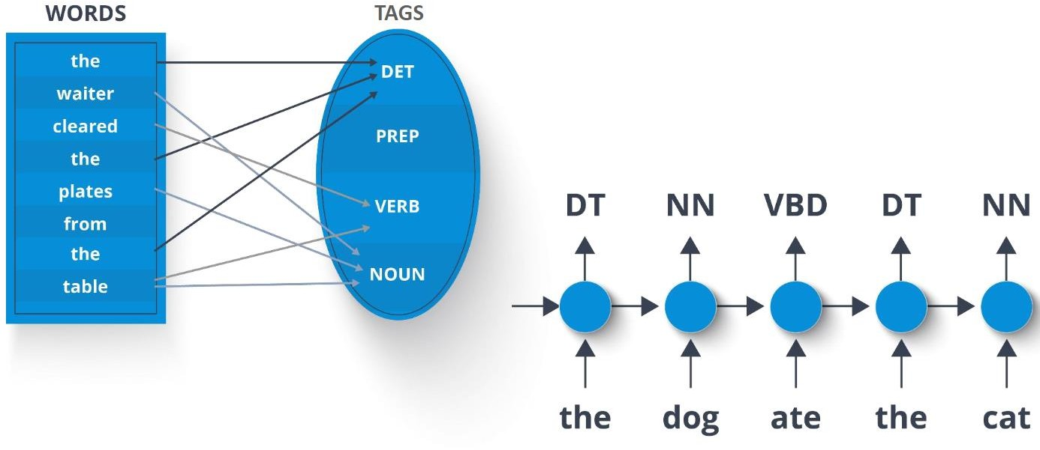
Example

Slide 49
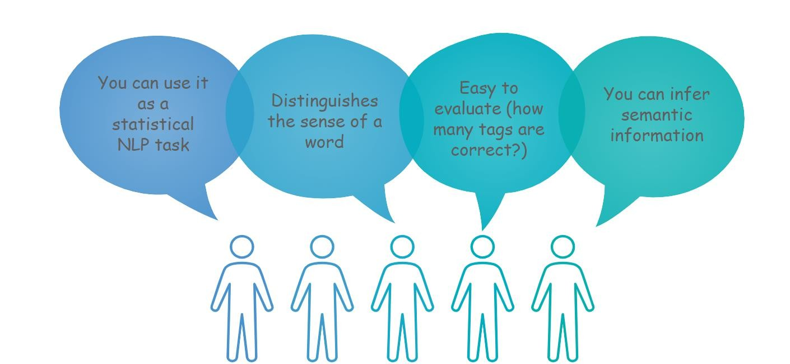
Need of POS tag

Slide 50
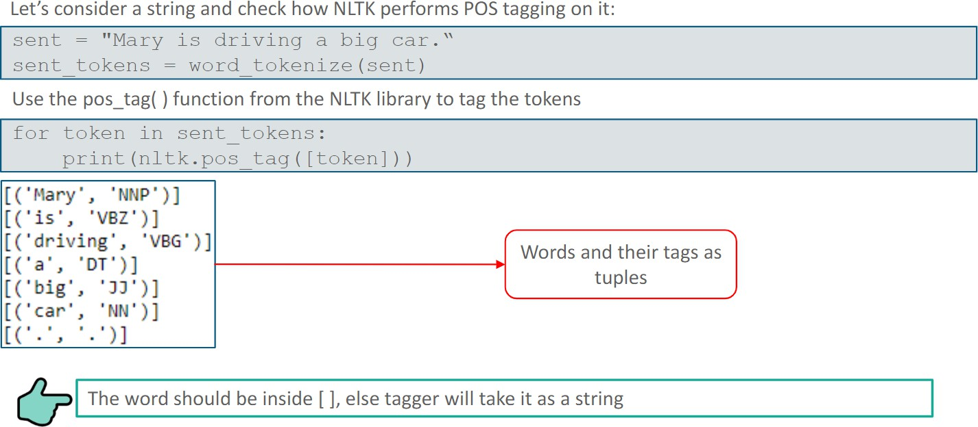

Slide 51
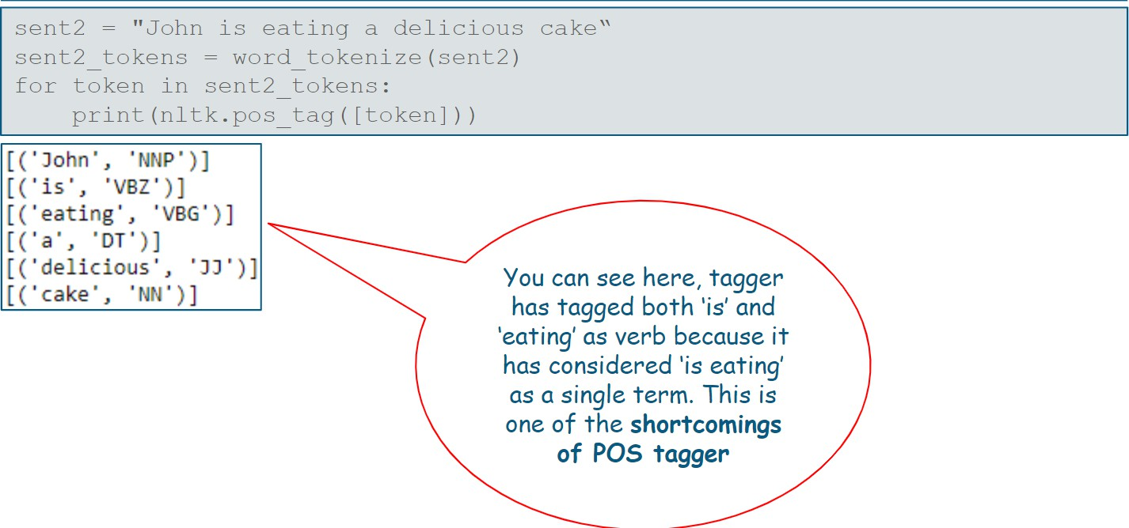

Slide 52
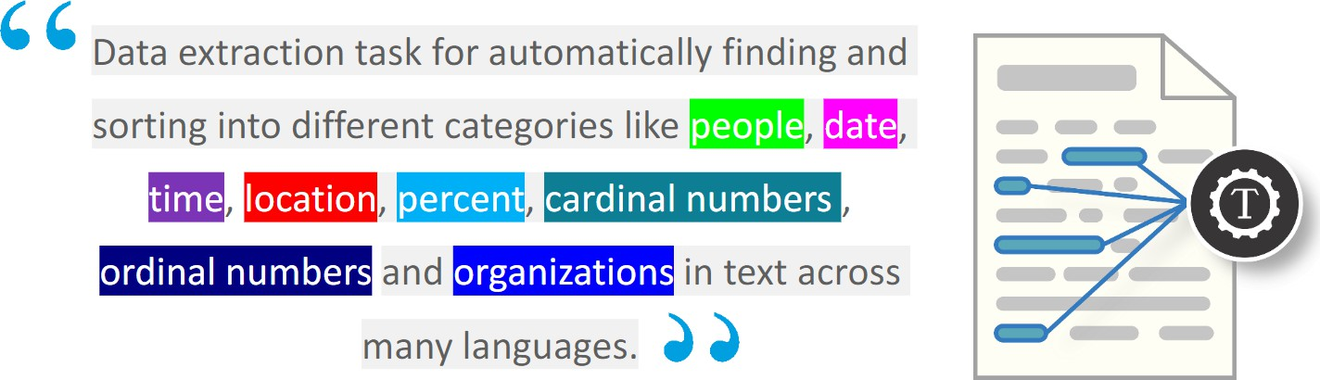
What is NER?

Slide 53
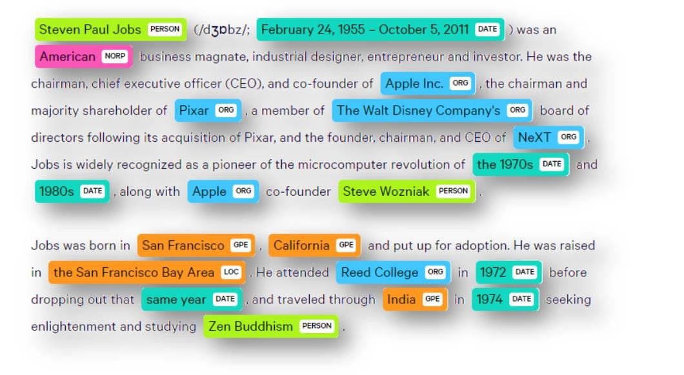
Example

